Slide 1


Sprint 2 Retrospective
Cloud Group 5

Slide 2



Sprint 2 Overview
Period from Week 9 to Week 10
Technology Stack Development
Stack A • Stack B • Comparison • SWOT Analysis
Designs
Mock UI • Data Schema
Group Reflection

Slide 3
Technology Stacks
STACK A
STACK B
Ruby (Ruby on Rails Framework)
MySQL
HTML 5, CSS3, JavaScript
Memcached
Apache HTTP Server
Linux
MD5+Token
Grafana
AWS EC2 server
Programming Language
Database
Frontend
Caching
Web Server
Operating System
Security
Monitoring
Cloud Provider
JavaScript, Python
MongoDB
HTML 5, CSS3, JavaScript
Redis
Nginx
Windows
MD5+Token, Yubikeys
Sentry
AWS EC2 server

Slide 4
Comparison
Cost
Stack A | Stack B
Ruby/Ruby on Rails – $0 MySQL – $0 Memcached – $0 Linux – $0 Grafana – $0 Apache – $0 MD5+Token – $0 AWS – $0.0333 (hourly) | JavaScript - $0 Python - $0 Windows 10 Pro – $339 (once) Sentry (Team) – $26 (month) Redis – $0 Nginx – $2500 (year) MongoDB (40GB) – $0.75 (hourly) MD5+Token - $0 Yubikeys - $45 (per employee) AWS - $0.0448 (hourly)

Slide 5
Comparison
Skill level required
Stack A | Stack B
Ruby/Ruby on Rails – extremely beginner friendly and RubyGems can help with implementation authentication etc. MySQL – relatively simple to learn and understand (some group members know it) HTML/CSS/JavaScript – easy to learn and improve skillset Memcached – designed to be simple and generic Apache – well-known and easy to configure Linux – open-source OS, easy to set up and modify if required MD5+Token – easy to implement as MySQL supports MD5 password hashing Grafana – simple open source analytics and monitoring and quick to deploy AWS – makes deploying web apps simple | JavaScript/Python – some of the easier programming languages to learn and have libraries/frameworks to help with implementation MongoDB (40GB) – can be difficult without knowledge of databases HTML/CSS/JavaScript – easy to learn and improve skillset Redis – made up of common data structures Nginx – the hardest part will be configuration Windows 10 Pro – one of most common OS and easy to set up as a web server MD5+Token – easy to implement as MongoDB supports MD5 password hashing Yubikeys – easy to obtain and use Sentry (Team) – makes logging and error handling simple AWS – makes deploying web apps simple

Slide 6
Comparison
Scalability
Stack A | Stack B
Ruby/Ruby on Rails – demonstrates opportunity for horizontal scaling MySQL – usually replaced by PostgreSQL or MongoDB to accommodate large quantities of data when scaled (but can scale up) Memcached – distributed and multithreaded architecture means it is easy to scale up or out Apache – easily scaled using AWS AWS – auto-scaling features to ensure correct number of EC2 instances are being used HTML/CSS - scalability includes responsive design which needs to be considered when creating a website and this can be achieved with HTML/CSS. | JavaScript/Python – JavaScript is flexible and scalable, but Python is less scalable in terms of performance and execution speed MongoDB (40GB) –non-relational DB that is better for scaling out Redis – data is stored in the server’s main memory which ensures high availability and scalability Nginx – scale to several concurrent connections on modern hardware AWS – same as Stack A HTML/CSS – same as Stack A

Slide 7
SWOT Analysis
Stack A
STRENGTHS | WEAKNESSES
• Low cost for the technologies • Technologies are relatively easy to implement • Relational databases can allow different security for each table (user permissions) | • Limited knowledge of creating a web application • Scalability more limited than Stack B • Limitations could be present in the structure of relational databases
OPPORTUNITY | THREATS
• Use the information and learned skills to create a mobile application • Implement more security measures (potentially those mentioned for Stack B) • Could create additional features such as a chat function | • SQL injection • Cross-site scripting attacks • DDoS attacks • Information leakage

Slide 8
SWOT Analysis
Stack B
STRENGTHS | WEAKNESSES
• More security features • Non-relational database can handle structured and unstructured data • Can be easily scaled out and up and can also handle different types of data – making it useful if the website features change in the future | • Higher cost to implement and continue operating • Extra app to carry and pay for • May need to seek advice on implementation which will cost more money
OPPORTUNITY | THREATS
• Data storage capacity • More possibilities for scaling (can accommodate for more users and potentially more functions of the website) | • Loss of device (Yubikey) could lead to a breach of the system • Remote command/code execution • Database must be properly configured to prevent information leakage and unauthenticated access

Slide 9
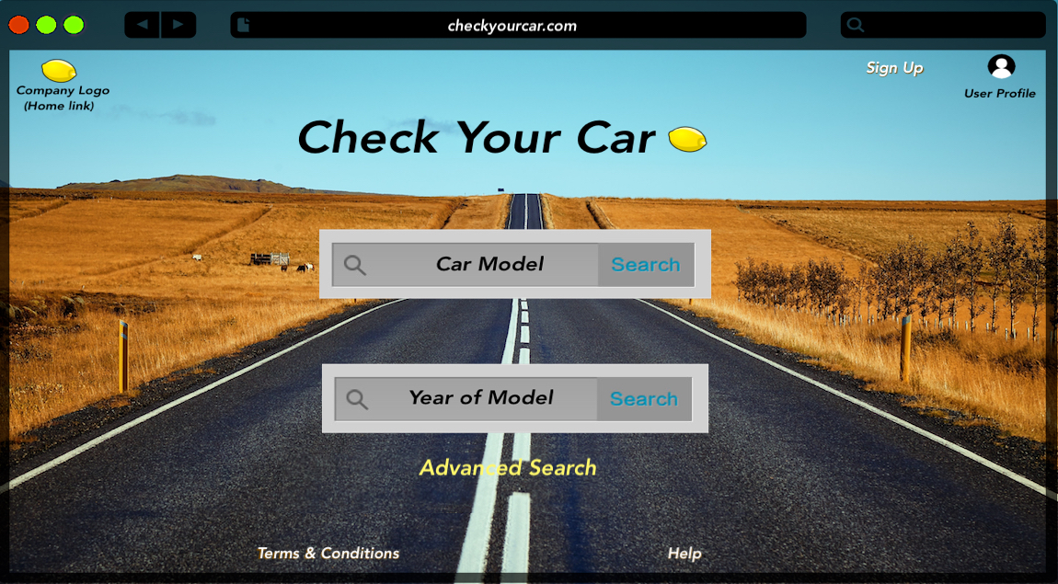
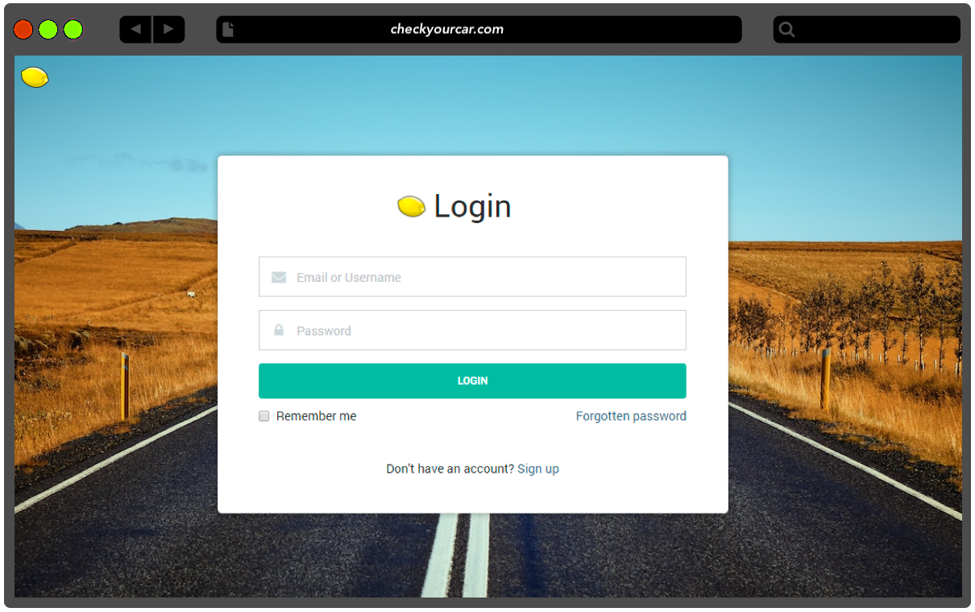
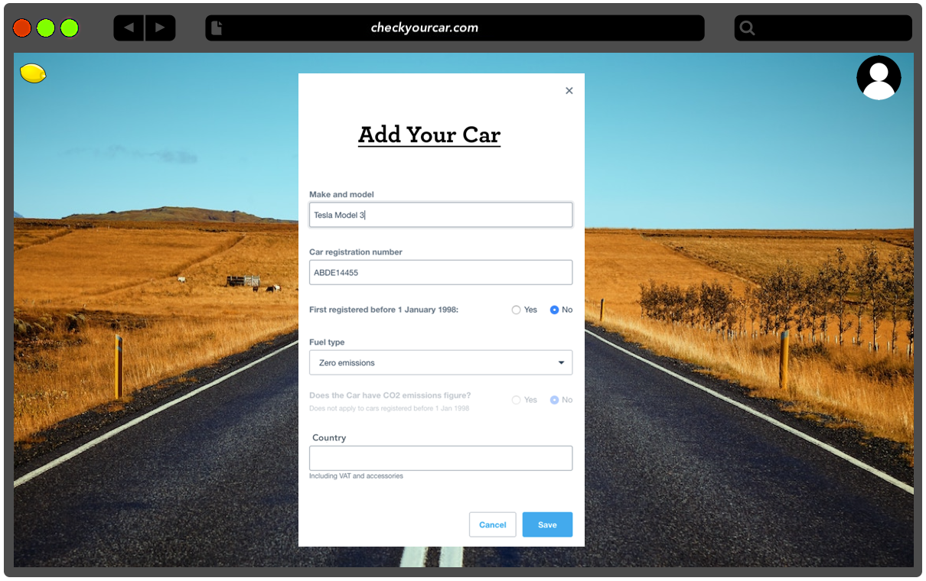
UI Designs

Slide 10
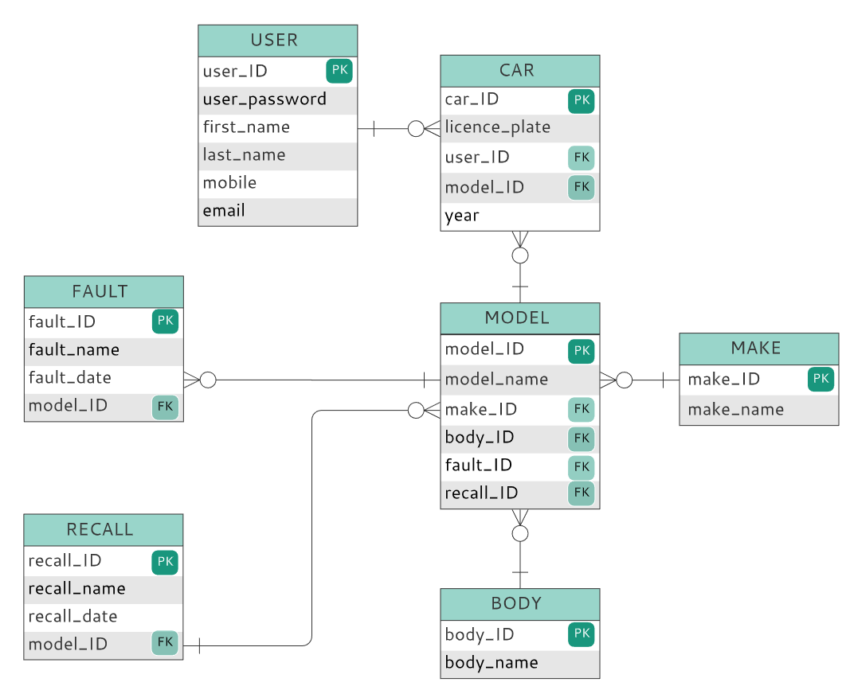
Database Schema

Slide 11
Group Reflection / Retrospective
WHAT WORKED WELL?
WHAT DIDN’T WORK WELL?
ISSUES WE FACED
Communication – voice calls and messages
Time management
Use of shared platforms
Limited use of Trello board
Working remotely
External influences (such as work)
Technical difficulties (from working remotely)
HOW TO FIX THE ISSUES?
Dedicated times that the team could work together simultaneously
Have a back-up communication tool to combat technical difficulties.

